Slide 1

Customer Shopping Behavior Analysis
A practical walkthrough for Data analysts working with Shopping Data

Slide 2

What We're Working With
3,900
18
37
Transaction Records
Data Columns
Missing Values
Rich customer & purchase attributes
Only in Review Rating field
Complete customer purchase dataset

Slide 3

Step 1: Upload & Initial Inspection
Import Your Data
from google.colab import files
uploaded = files.upload()
import pandas as pd
df = pd.read_csv('customer_shopping_behavior.csv')
Quick Look
4 product categories tracked
50 unique locations
Age range: 18-70 years
Purchase amounts: $20-$100

Slide 4



Step 2: Handle Missing Data
01
02
Identify Nulls
Strategic Fill
Run df.isnull().sum() to locate gaps
Use category-based mean for Review Rating
03
Verify Clean
Confirm zero nulls remain in dataset
df['Review Rating'] = df.groupby('Category')['Review Rating'].transform(lambda x: x.fillna(x.mean()))

Slide 5
Step 3: Clean & Standardize
Remove Duplicates
Strip Extra Spaces
Normalize Column Names
df = df.drop_duplicates()
df = df.apply(lambda x:x.str.strip() if x.dtype == "object" else x)
df.columns = df.columns.str.lower()
df.columns = df.columns.str.replace(' ','_')

Slide 6
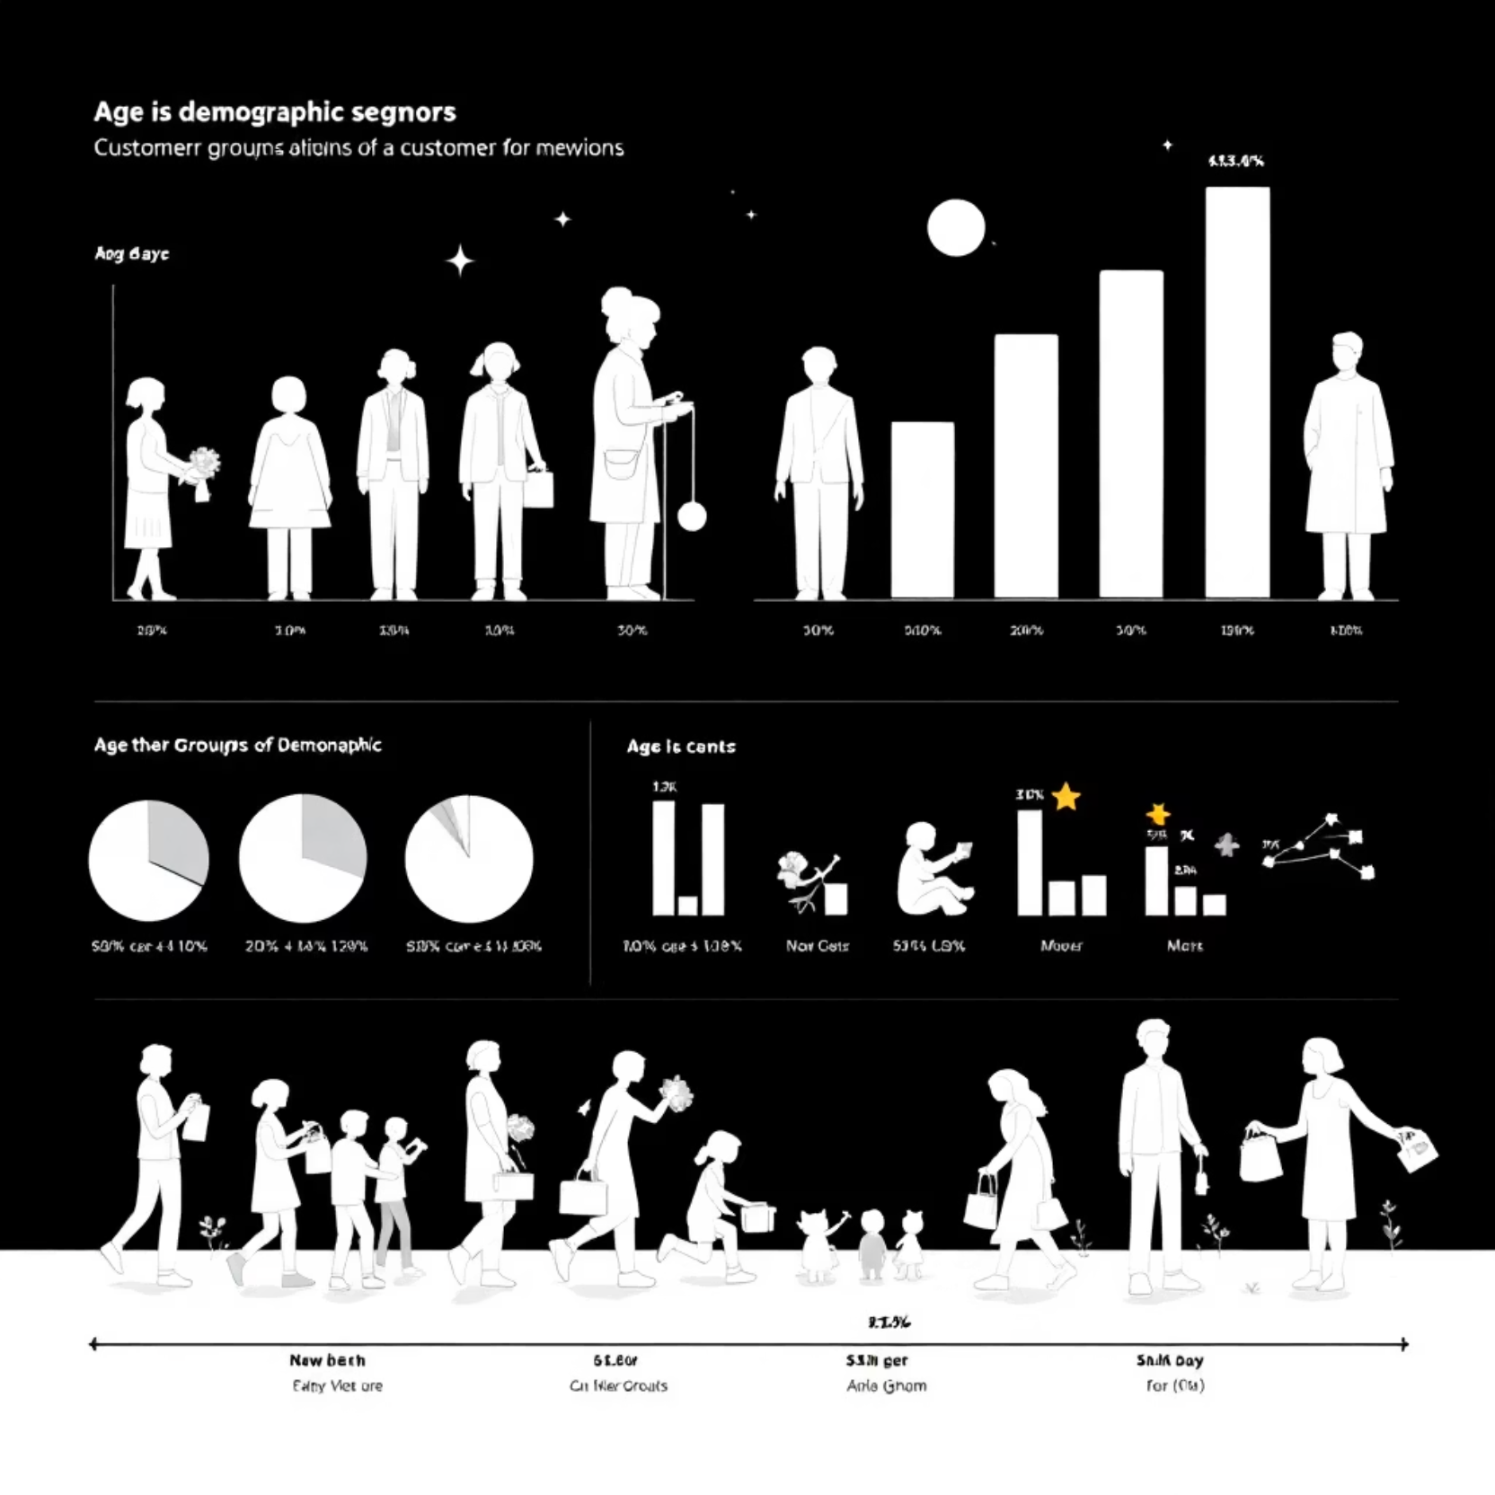
Step 4: Engineer New Features
Age Group Segmentation
labels = ['Young-Adult', 'Adult',
'Middle-Aged', 'Senior']
df['age_group'] = pd.qcut(df['age'],
q=4,
labels=labels)
Creates quartile-based customer segments for targeted analysis

Slide 7
Purchase Frequency Mapping
Weekly
1
7 days
2
Fortnightly
14 days
Monthly
3
30 days
4
Quarterly
90 days
Annually
5
365 days
frequency_mapping = {
'Weekly': 7, 'Fortnightly':14, 'Bi-Weekly': 14,
'Monthly': 30, 'Every 3 Months':90,
'Quarterly': 90, 'Annually': 365
}
df['purchase_frequency_days'] = df['frequency_of_purchases'].map(frequency_mapping)

Slide 8
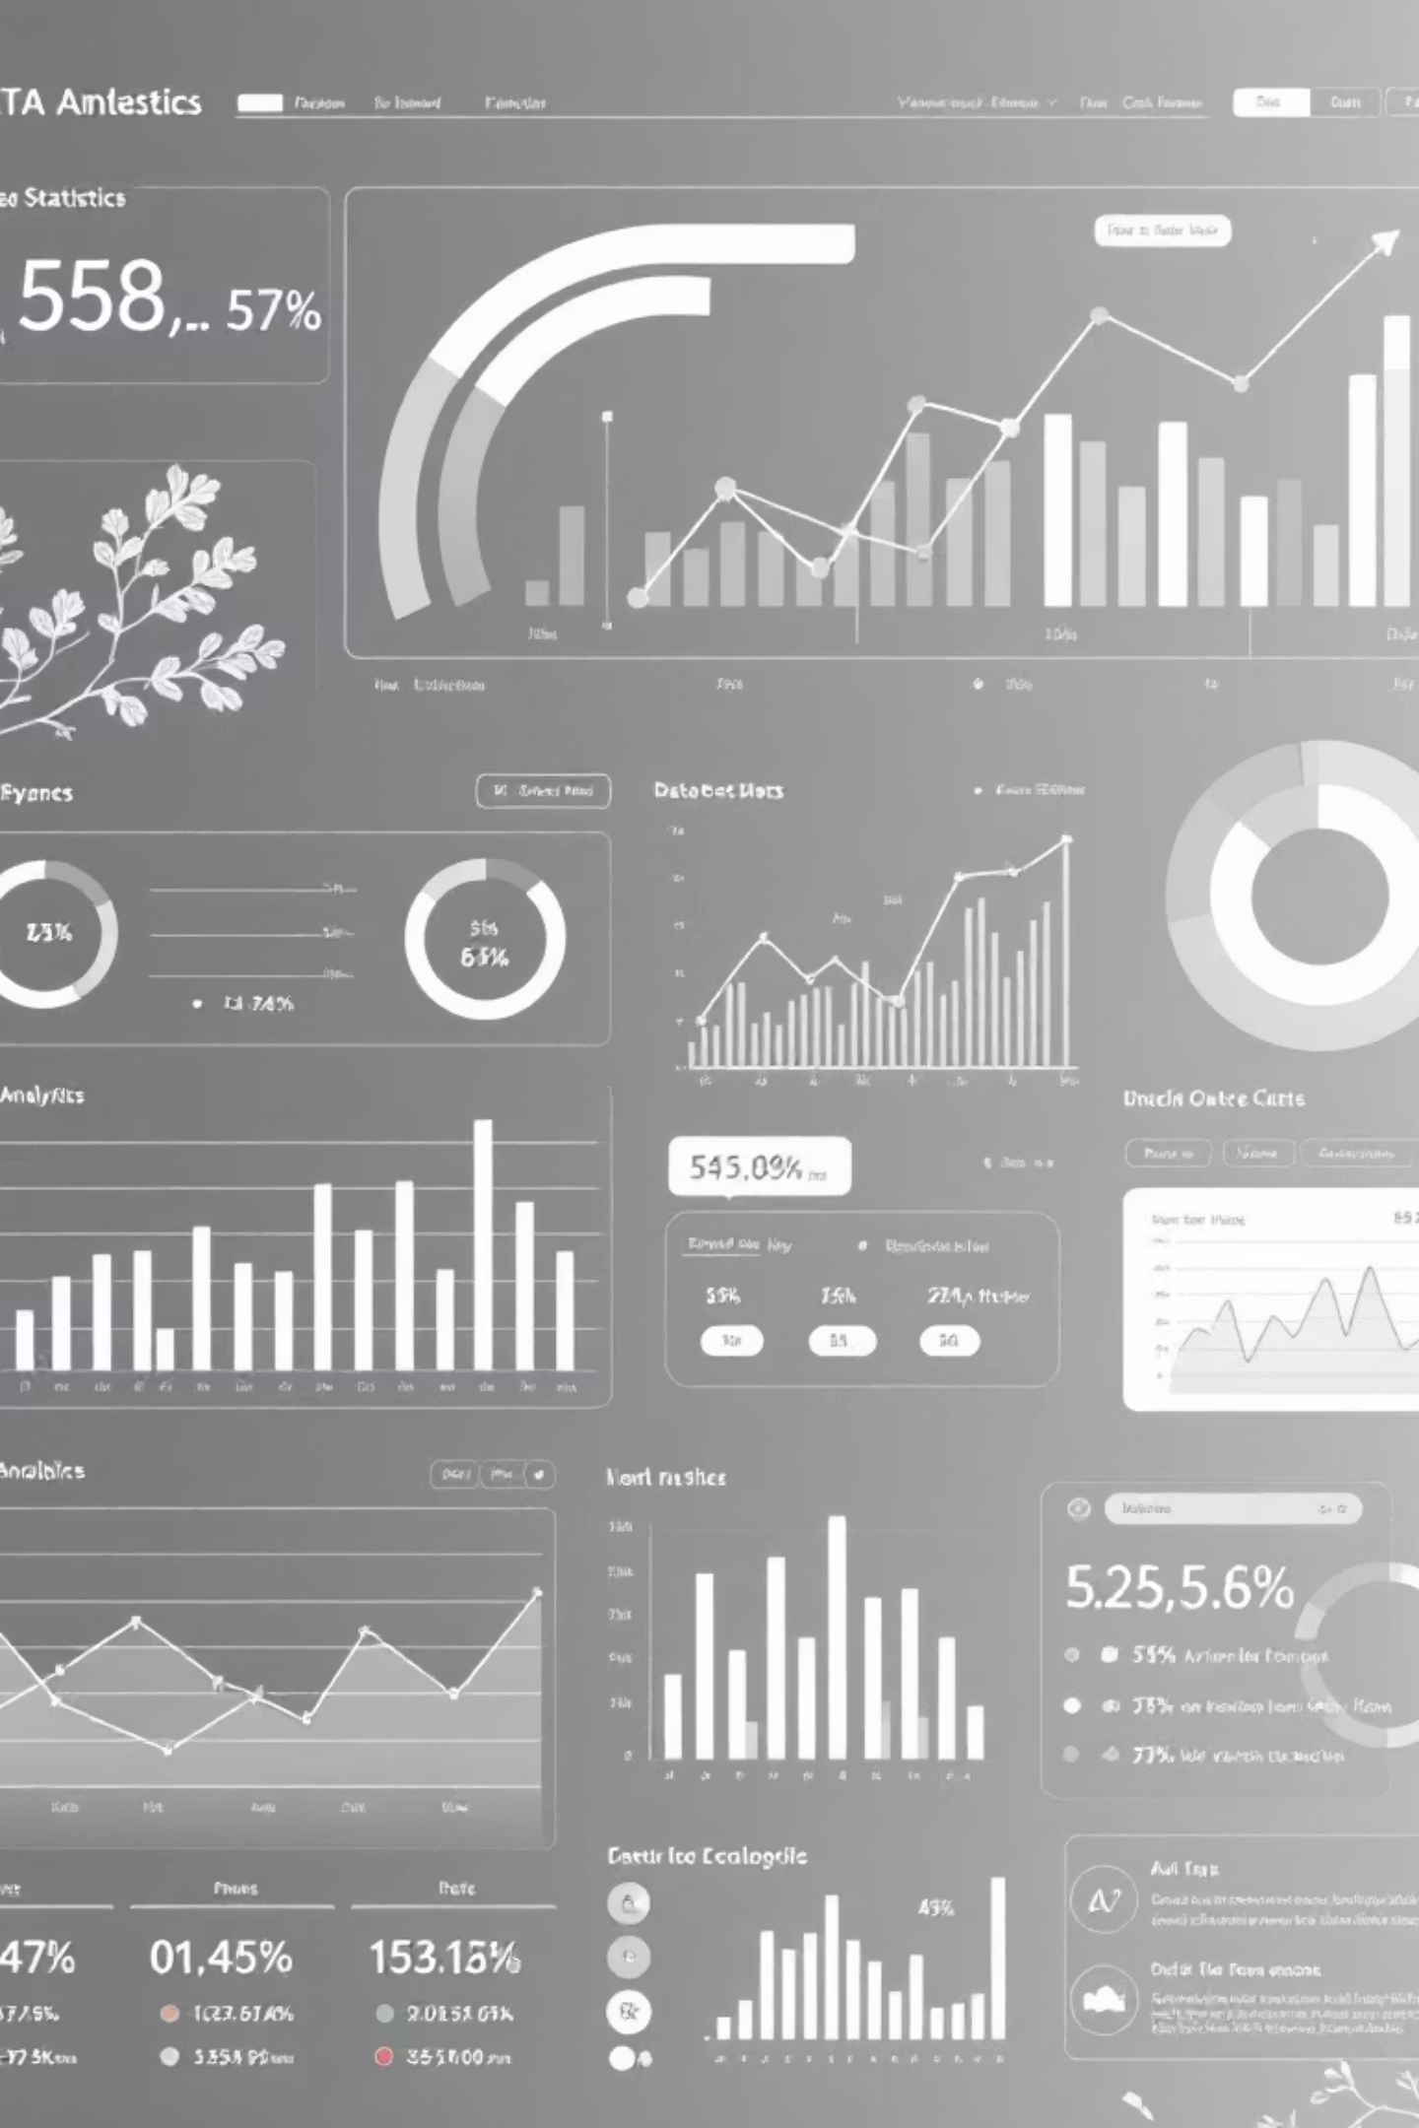
Key Dataset Characteristics
Customer Demographics
Purchase Behavior
Avg purchase: $59.76
68% Male customers
Rating range: 2.5-5.0
Median age: 44 years
Size M most popular (45%)
All 50 US states represented
Product Mix
Clothing: 45% of sales
25 unique items tracked
Spring highest season (26%)

Slide 9

Data Quality Insight
Redundant Columns Detected
(df['discount_applied'] ==
df['promo_code_used']).all()
# Returns: True
Discount Applied and Promo Code Used are 100% identical
Consider dropping one column to reduce data redundancy

Slide 10






Your Clean Dataset is Ready
Zero Null Values
All missing data handled intelligently
Standardized Format
Clean column names, no duplicates
Enhanced Features
Age groups & frequency mappings added
Analysis Ready
3,900 clean records for insights
Now you're ready to build visualizations, run statistical analysis, or feed this into machine learning models

